Slide 1
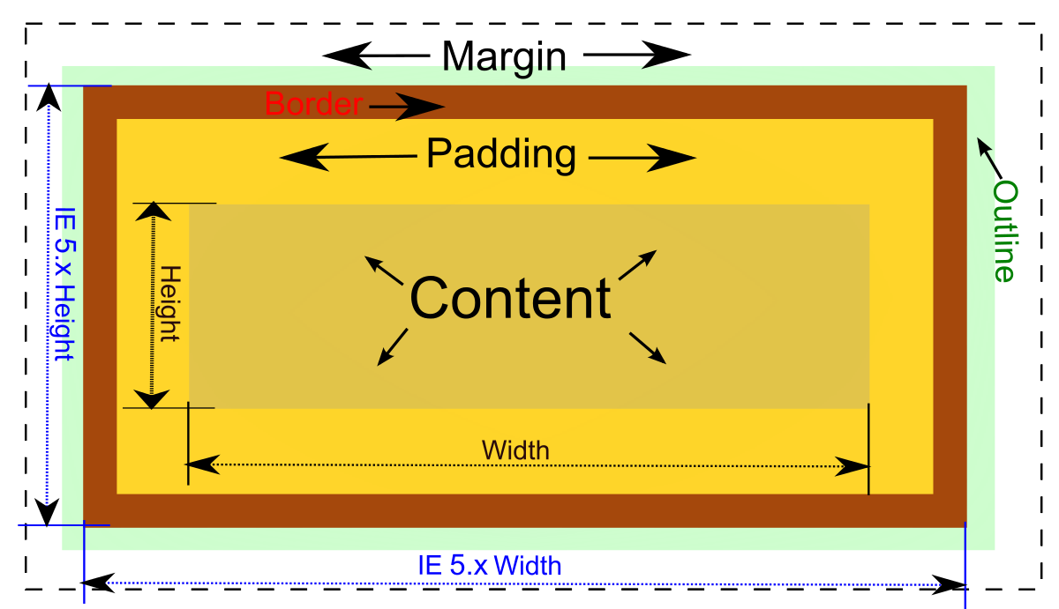
CSS Box Model
Margin, Border, Paddings, Actual Content
SoftUni Team
Technical Trainers
Software University
https://softuni.bg

Slide 2
Table of Contents
CSS Box Model
Block and Inline Elements
Width and Height
Padding, Margin and Border
Box Sizing
Notes:
2

Slide 3
Have a Question?
sli.do
#html-css
Notes:
3

Slide 4

What is Box Model?

Slide 5
What is CSS Box Model?
The CSS box model is essentially a box that wraps around every HTML element
All HTML elements can be considered as boxes
The term "box model" is used when talking about design and layout
CSS box model consists of margins, borders, padding, and the actual content
5

Slide 6
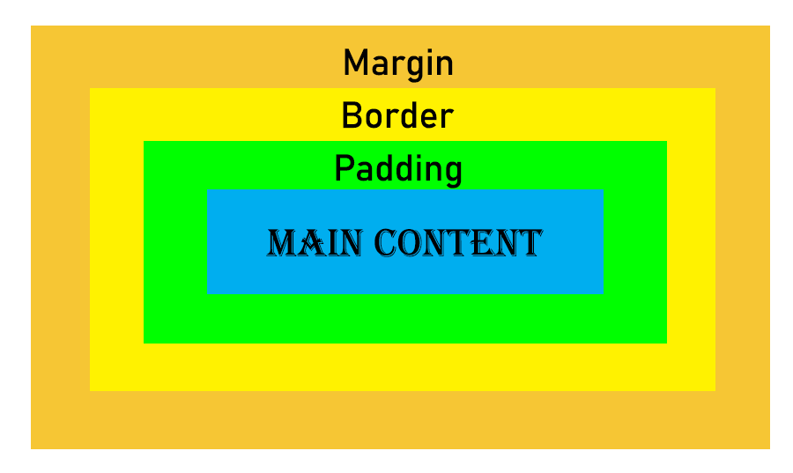
Parts of a Box
Content Box - the area where your content is displayed, which can be sized using properties like width and height
Padding Box - the padding sits around the content
Border Box - the border box wraps the content and any padding
Margin Box - the margin wrapping the content, padding and border

Slide 7
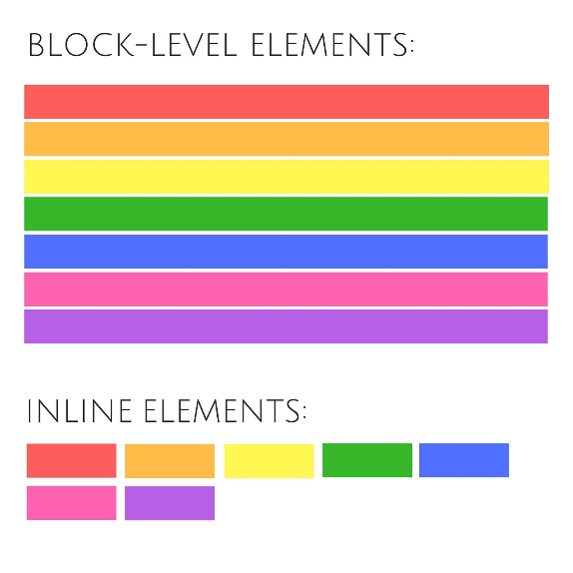
Block-level and Inline HTML Elements

Slide 8
Block and Inline Elements
HTML is made up of various elements that act as the building blocks of web pages
CSS has two different types of boxes - block and inline
Block Elements
Inline Elements
Inline-block Elements

Slide 9
Block Elements
Block element: starts on a new line, and fills up the horizontal space left and right on the web page
Some examples of block elements are:
main, header , article , section , fieldset , nav , ul , ol , li , form , h1-h6 , p , div

Slide 10
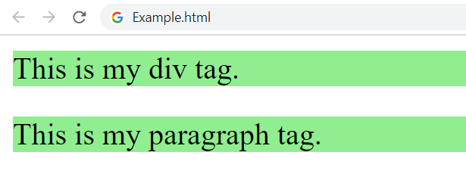
Block Elements – Example
<body>
<div>This is my div tag.</div>
<p>This is my paragraph tag.</p>
</body>
p, div {
background-color: lightgreen;
}

Slide 11
Inline Elements
Inline element: don't start on a new line. They appear on the same line as the content and tags beside them
Some examples of inline-block elements are:
a, label, map, span, strong, em, i, img, textarea, input, button, select
You can add margins and padding just on right and left sides of any inline element

Slide 12
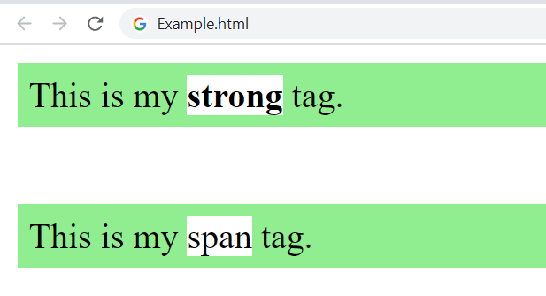
Inline Elements – Example
<body>
<div>
This is my <strong>strong</strong> tag.
</div>
<p>This is my <span>span</span> tag.</p>
</body>
p, div {
padding: 5px;
background: lightgreen;
}
span, strong {
background: white;
}

Slide 13
Inline-Block Elements
Inline-block elements are similar to inline elements
They can have padding and margins added on all four sides
You have to declare display: inline-block in your CSS code
One common use for using inline-block is for creating navigation links horizontally

Slide 14

Inline-Block Elements – Example
<ul>
<li>Home</li>
<li>About Us</li>
<li>Clients</li>
<li>Contacts</li>
</ul>
ul {
background-color: #f0b27a;
padding: 20px;
list-style-type: none;
text-align: center;
}
li {
display: inline-block;
padding: 0 20px;
font-size: 20px;
}

Slide 15
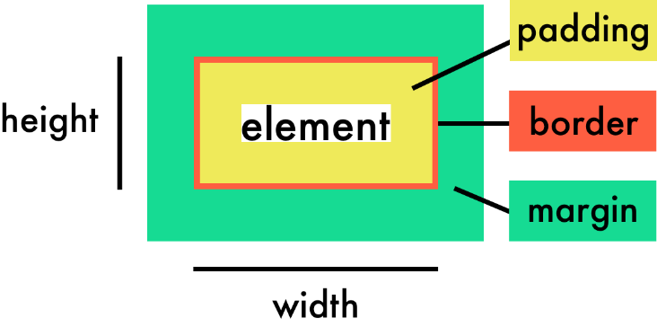
CSS Width and Height Dimensions

Slide 16
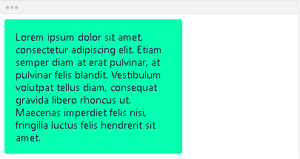
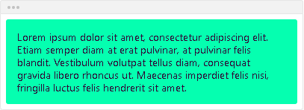
Width
Defines the width of the element
width: auto; - the element will automatically adjust its width to allow its content to be displayed correctly
width: 240px; - you can use numeric values like pixels, (r)em, percentages...

Slide 17
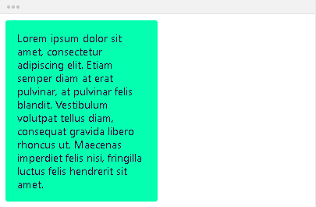
Width
width: 50%; - if you use percentages, the value is relative to the container's width

Slide 18
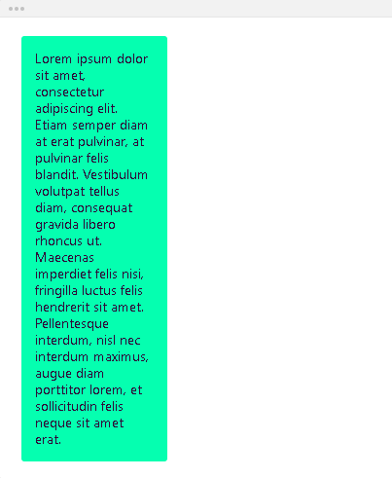
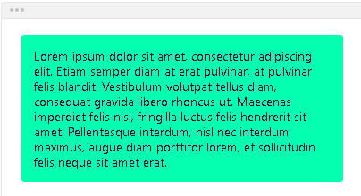
Max-width
Max-width - defines the maximum width the element can be
max-width: none; - the element has no limit in terms of width
max-width: 150px;

Slide 19
Max-width
max-width: 2000px; - you can use numeric values like pixels, (r)em, percentages...
If the maximum width is larger than the element's actual width, the max width has no effect

Slide 20
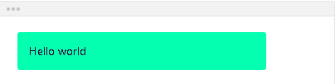
Min-width
Min-width - defines the minimum width the element
min-width: 300px; - if the minimum width is larger than the element's actual width, the min width will be applied

Slide 21
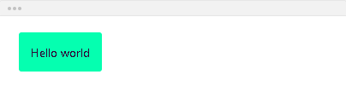
Min-width
If the minimum width is smaller than the element's actual width, the min width has no effect - min-width: 5px;

Slide 22
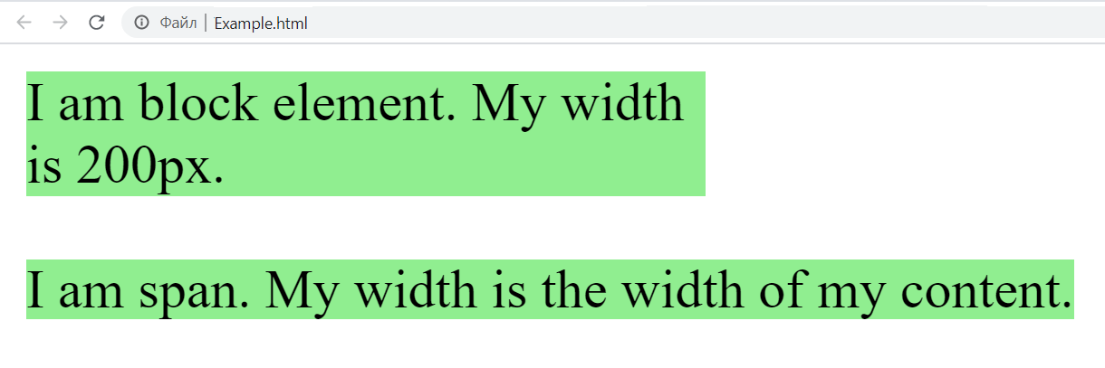
Width – Example
<body>
<div>
I am block element. My width is 200px.
</div>
<span>I am span. My width is the width of my content.</span>
</body>
div, span {
width: 200px;
background-color: lightgreen;
}

Slide 23
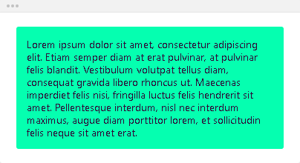
Height
Height - defines the height of the element
height: auto; - the element will automatically adjust its height to allow its content to be displayed correctly

Slide 24
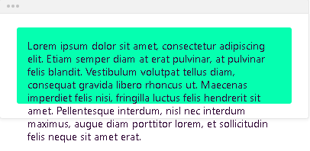
Height
height: 100px; - you can use numeric values like pixels, (r)em, percentages...
If the content does not fit within the specified height, it will overflow
How the container will handle
this overflowing content is
defined by the overflow property

Slide 25
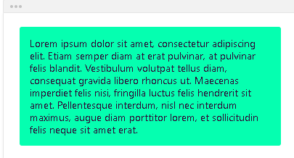
Max-height
Max-height - defines the maximum height the element can be
max-height: none; - the element has no limit in terms of height
max-height: 2000px;
- if the maximum height is larger
than the element's actual height,
the max height has no effect

Slide 26
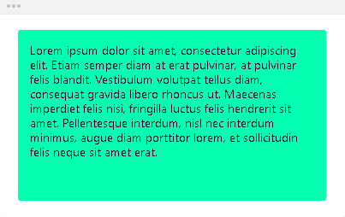
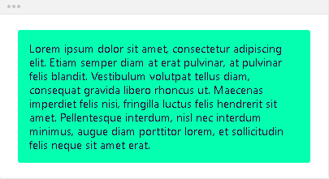
Min-height
Min-height - defines the minimum height the element
min-height: 200px; - if the minimum height is larger than the element's actual height, the min height will be applied
min-height: 5px; - if the minimum height is smaller than the element's actual height, the min height has no effect

Slide 27
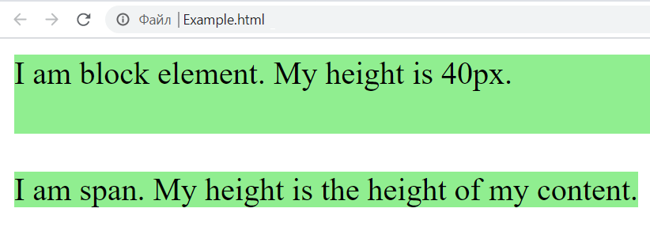
Height – Example
<body>
<div>
I am block element. My height is 40px.
</div>
<span>I am span. My height is the height of my content.</span>
</body>
div, span {
height: 40px;
background: lightgreen;
}

Slide 28
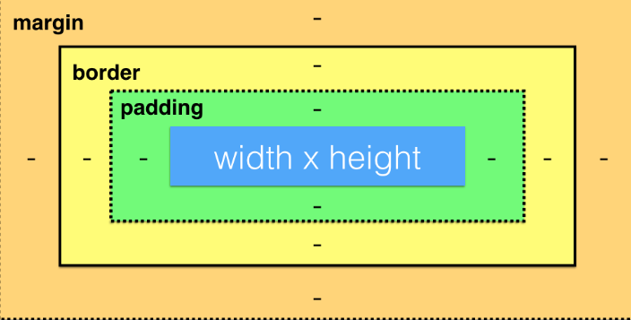
CSS Box Model Layers

Slide 29
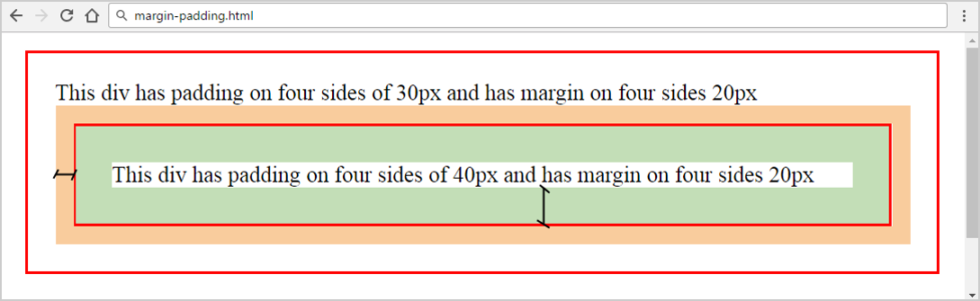
Margins and Paddings
margin
padding
margin-right
margin-top
margin-bottom
div {
margin: 20px 20px 20px 20px;
padding: 30px 30px 30px 30px;
}
margin-left

Slide 30
Margin
Margin - defines the space outside the element
Margin: shorthand property:
div {
margin-top: 50px;
margin-left: 10px;
margin-bottom: 50px;
margin-right: 0;
}
div {
margin: 50px 0 50px 10px;
}

Slide 31
Padding
Padding - defines the space inside the element
Padding: shorthand property:
div {
padding-top: 50px;
padding-left: 0;
padding-bottom: 50px;
padding-right: 0;
}
div {
padding: 50px 0;
}

Slide 32
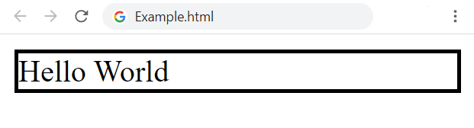
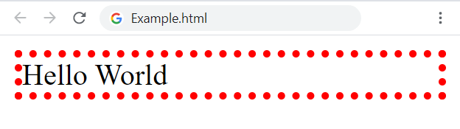
Border
Border: shorthand property for border-width, border-style and border-color
border: 2px solid black;
border: 4px dotted red;

Slide 33
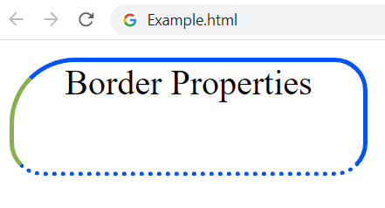
Border Properties
div {
width: 160px;
height: 50px;
border-width: 2px;
border-style: solid;
border-color: #0053ff;
border-radius: 15px;
border-top-left-radius: 30px;
border-bottom-style: dotted;
border-left-color: #89af4c;
text-align: center;
}

Slide 34
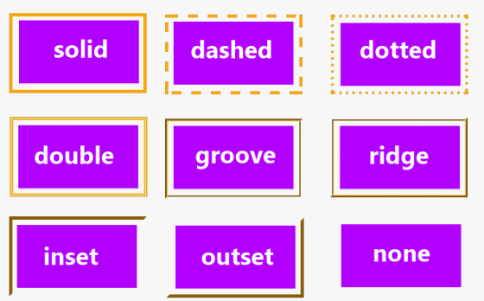
CSS Borders

Slide 35

Include the Padding and Border in an Element's Total Width and Height

Slide 36
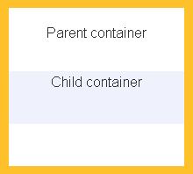
Box-sizing
Sets how the total width and height of an element is calculated
content-box - initial and default value
The width and height properties include the content
They do NOT include the padding, border and margin
div {
box-sizing: content-box;
width: 200px;
}

Slide 37
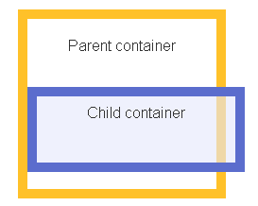
Box-sizing
The full width is: 200px + 2*10px + 2*5px = 230px
div {
box-sizing: content-box;
width: 200px;
border: 10px solid #5b6dcd;
padding: 5px;
}

Slide 38
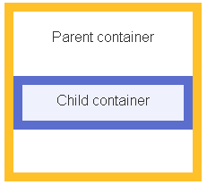
Box-sizing
border-box - the width and height of the element apply to all parts of the element: the content, the padding and the borders
The full width is 200px
The content width is equal to: 200px - 2*10px - 2*5px = 170px
box-sizing: border-box;
width: 200px;
border: 10px solid #5b6dcd;
padding: 5px;

Slide 39
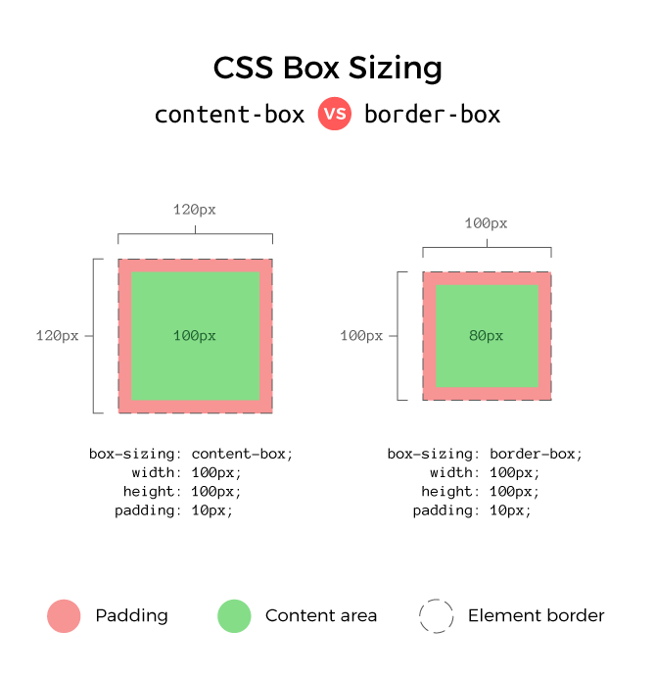
Content-box vs Border-box

Slide 40
Universal Box-sizing
The box-sizing Reset takes care of the box-sizing of every element by setting it to border-box using universal CSS selector
Save your time and don't write the same thing again-and-again
Set the "universal box-sizing" with inheritance:
html {
box-sizing: border-box;
}
*,
*:before,
*:after {
box-sizing: inherit;
}

Slide 41

Summary
What is Box Model?
Width and Height to the elements
What are the padding, border and margin?
What is box-sizing?
How to reset box-sizing?
Notes:
41

Slide 42
Questions?
Notes:
42

Slide 43










SoftUni Diamond Partners

Slide 44



Educational Partners

Slide 45

License
This course (slides, examples, demos, exercises, homework, documents, videos and other assets) is copyrighted content
Unauthorized copy, reproduction or use is illegal
© SoftUni – https://about.softuni.bg/
© Software University – https://softuni.bg
Notes:
45

Slide 46
Trainings @ Software University (SoftUni)
Software University – High-Quality Education, Profession and Job for Software Developers
softuni.bg, about.softuni.bg
Software University Foundation
softuni.foundation
Software University @ Facebook
facebook.com/SoftwareUniversity
Software University Forums
forum.softuni.bg
46
Notes:
46

